Slide 1
Second International Investment Forum
Current situation and future opportunities for PPP
Bartosz Mysiorski

Slide 2
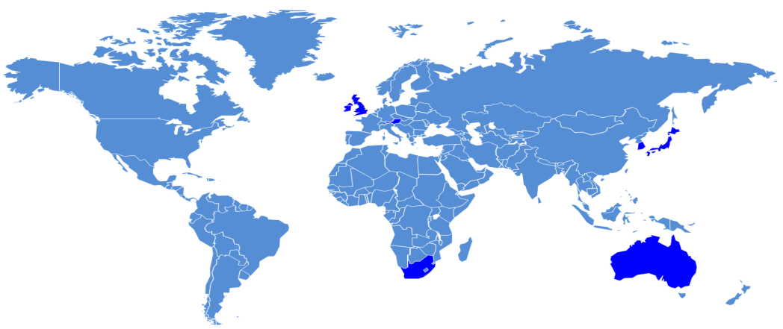
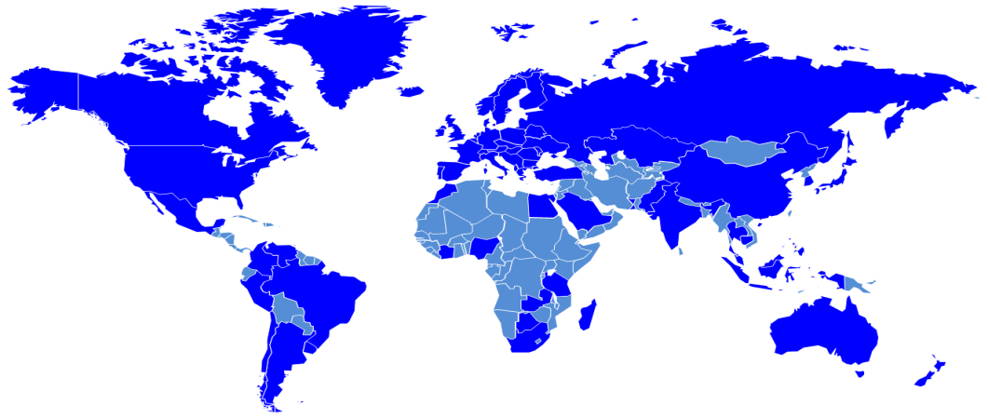
PPP 1997
PPP 2007
Source: PPPs in Developing Economies: Overcoming Obstacles to Private Sector Participation, DEPFA BANK 2007.

Slide 3
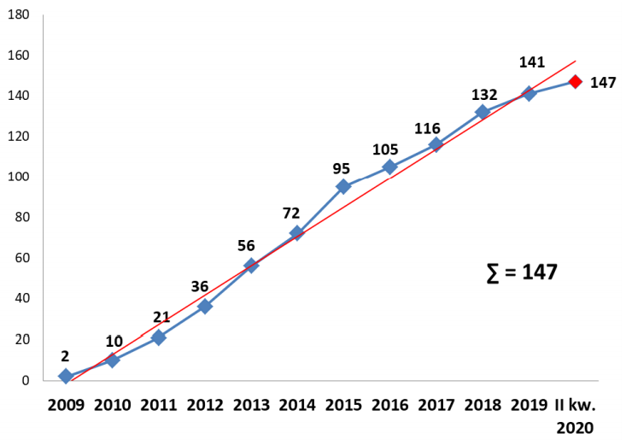
Characteristics of the PPP market in Poland
579 PPP procurement notices, 147 PPP contracts, value of the concluded PPP contracts, 7,5 mld PLN
Transport infrastructure (23), sport and tourism (21), energy efficiency (21)
Effecviteness 25%
Source: https://www.ppp.gov.pl/media/system/slowniki/Raport-z-rynku-PPP-II-kw-2020-07_2.pdf

Slide 4
Common mistakes in PPP projects in Poland:
Lack of proper analysis and lack of market testing
Unrealistic expectations of public authority regarding private partner
Lack of flexibility during the negotiations
Lack of knowledge in regarding PPP
Ineffective management of PPP contacts

Slide 5
Success factors of PPP in Poland
Proper analysis (assessment of effectiveness)
Reliable documentation
Human factor – political champion and qualified people in public side
Professional advisory services,
Strategic long-term thinking
Market testing and approriate communication with private sector
PPP project proper structure – model, payment mechanism, risk allocation
Credibility of public side – e.g. pipeline of potential PPPs

Slide 6
Successful implementation of PPP – based on international experience
Necessary conditions:
Strong political support
Stable and friendly law
Predictable macroeconomic environment,
Readiness and maturity of the public sector
Reliable and solid private partners.
Sufficient conditions:
Develop national (local, regional) policies (strategies) to use forms of PPP, including:
Determination of preferred areas of PPP implementation,
Creating a system of organization and coordination, monitoring and evaluation of PPP projects including creation of the institutions which will carry out these functions,
Creating a system of promotion the PPP development (that are adequate for the functions of preparing PPP best practices, standards and patterns),
Preparation of PPP good practices, standard procedures and agreements’ patterns in order to support activities of institutions that: verify the choice of PPP and coordinate (monitor) the PPP development.
Developing the system of PPP knowledge popularization - conferences, courses, postgraduate studies.

Slide 7
PPP in CoV reality
Public power - stronger budgetary limitations ...
Private capital - stronger demand limitations ...
Partnership – positive answer?
Public entity | Private partner
Access to private capital Access to know-how Stabilization of the price level Operation Higher quality of public services | Stable long-term contract Business confidence Cooperation with a reliable partner Possibility of applying innovations Easier access to financing

Slide 8
Thank you for attention!
Bartosz Mysiorski
Chief Executive Officer, Centrum PPP
E-mail: bartosz.mysiorski@centrum-ppp.pl
Mobile: +48 519 138 517

